Slide 1

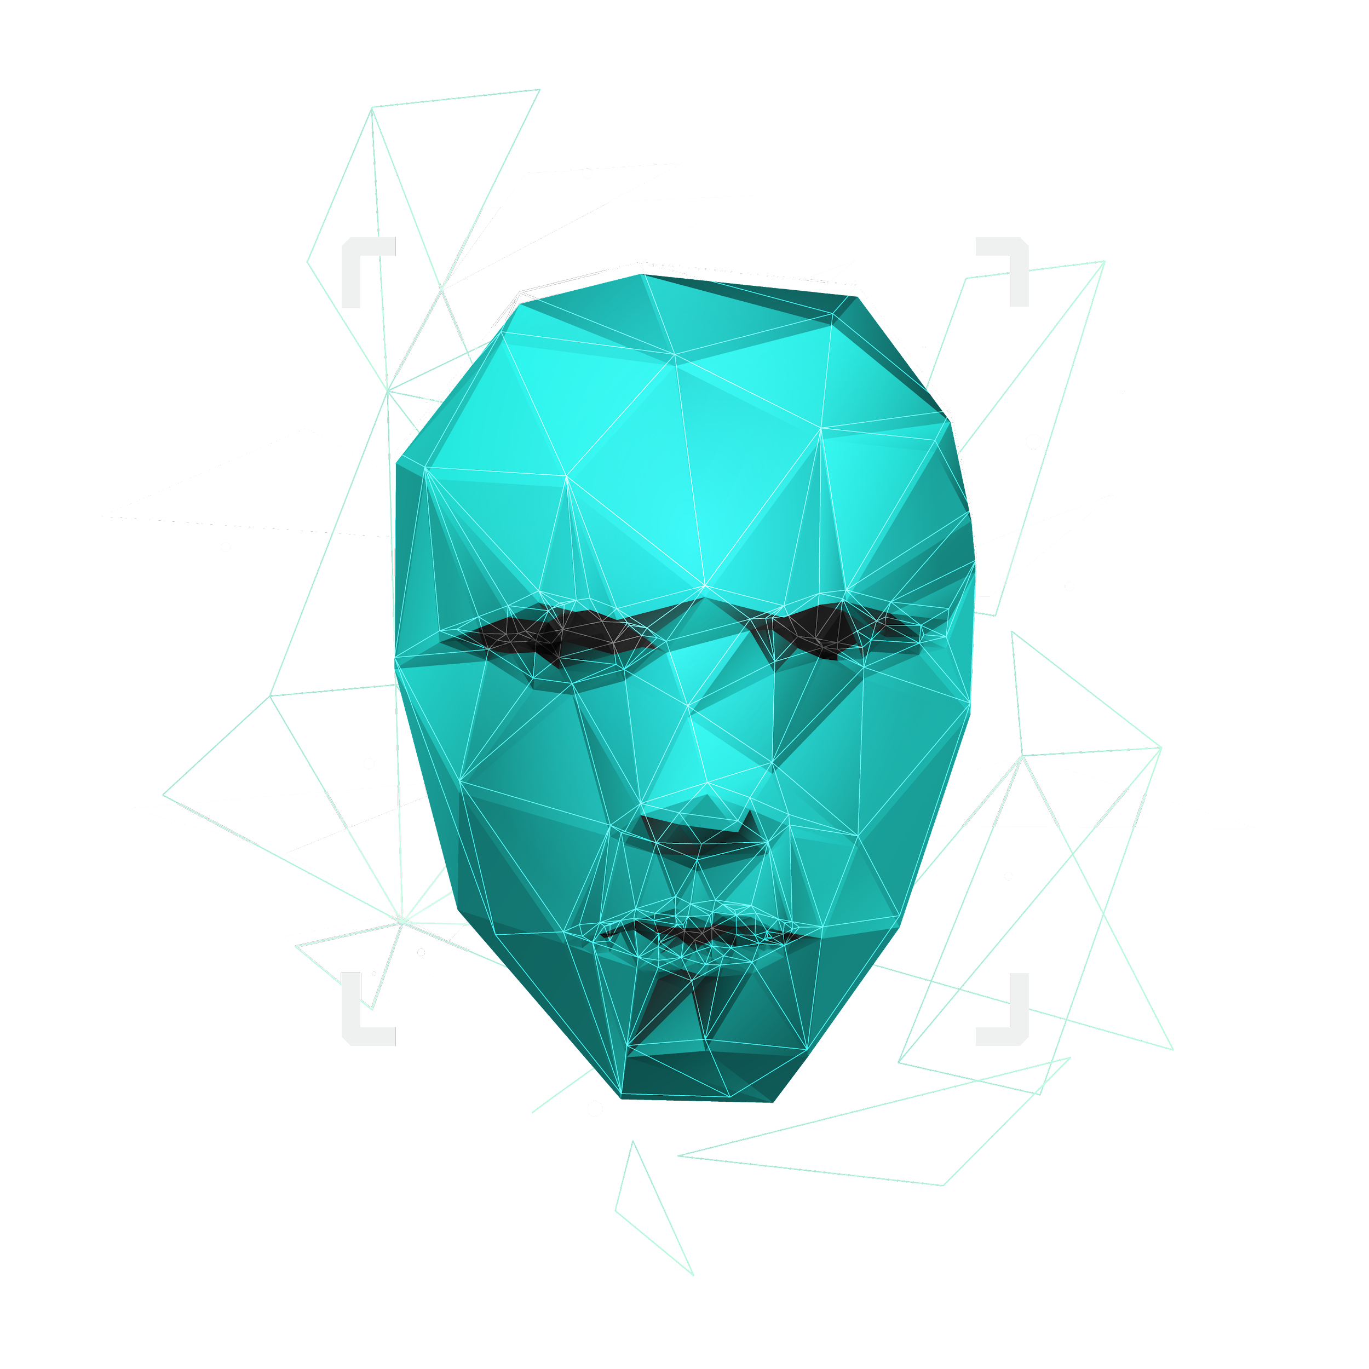
IMPLEMENTATION OF LIST IN PYTHON
S.ESTHER JEBA THANGAM
PRESENTERS

Slide 2

CONTENTS
What is List?
Accessing and operations – adding,replicating,slicing
Updating,appending and deletions
Functions and Methods using List

Slide 3
What is List?
Lists are the datastructure that is capable of holding different data types of data.
Lists are mutable
Lists values are separated by commas and enclosed within a square bracket[].
Lists can be retrieved using the slice operator [] and [ : ]
*
+
Lists allows duplications

Slide 4
Accessing and operations-adding,replicating & slicing?
Example of programs to see Git hub

Slide 5
Accessing and operations-updating,appending & deletions?
Example of programs to see Git hub

Slide 6
Functions of List?
Example of programs to see Git hub

Slide 7
Methods of List?
Example of programs to see Git hub

Slide 8
THANK YOU!
ANY QUESTIONS

